Slide 1
MyBuddy
___ The Mental Health App ___

Slide 2

The Motivation
The past one year has been hard on all of us due to the pandemic and having to stay indoors for the majority of our time. It inevitably took a toll on most of our mental health.

Slide 3
The Motivation
We believe this app can help people assess their mental health and provide them with helpful resources as much as we can. A lot of people struggle to talk to others or express their feelings when they are feeling low. So, the app allows users to provide details of a companion of their choice, who will be notified if the mental health score is below average along with how they are feeling. This can help in many ways.
The app suggests top therapists in the area for the user to consult if required. We also recommend mood boosting songs from genres like Pop, Rock, Hip-hop, etc from our music database to help the users.

Slide 4
Problem Statement
MyBuddy is a web application developed to help users assess their mental health . The application requires the user to register his details as well as the details of a companion of her choice (a friend, parent, etc). The user can take a short survey on which a sentiment analysis is performed using Machine Learning and Natural Language Processing techniques. The sentiment analysis is then used to determine the mental health score, based on which the user is recommended a top therapist in his area using web scraping, as well as songs from our music database. The app will alert his registered companion via email in case of a very low mental health score.

Slide 5
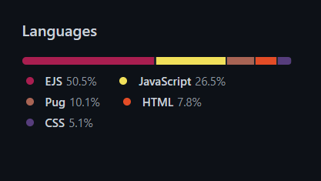
Topic, Tools and Technologies
MyBuddy - The Mental Health App
Topic : Web Development and Machine Learning
Tools : Node.js , Html5, Bootstrap CSS, EJS, Pug,Express, Cheerio
Technologies : Web Development, Machine Learning - Sentiment Analysis, Natural Language Processing, Web Scraping

Slide 6
Workflow Diagram
User registration and sign up
Mental Health Assessment
With few survey questions
Predicting the score using NLP (Sentiment Analysis )
Music (from different genres) recommended from our database based on predicted score
Therapist is recommended based on location entered using Web Scraping
Sending Email to the User with score report and Companion in
case of low score

Slide 7
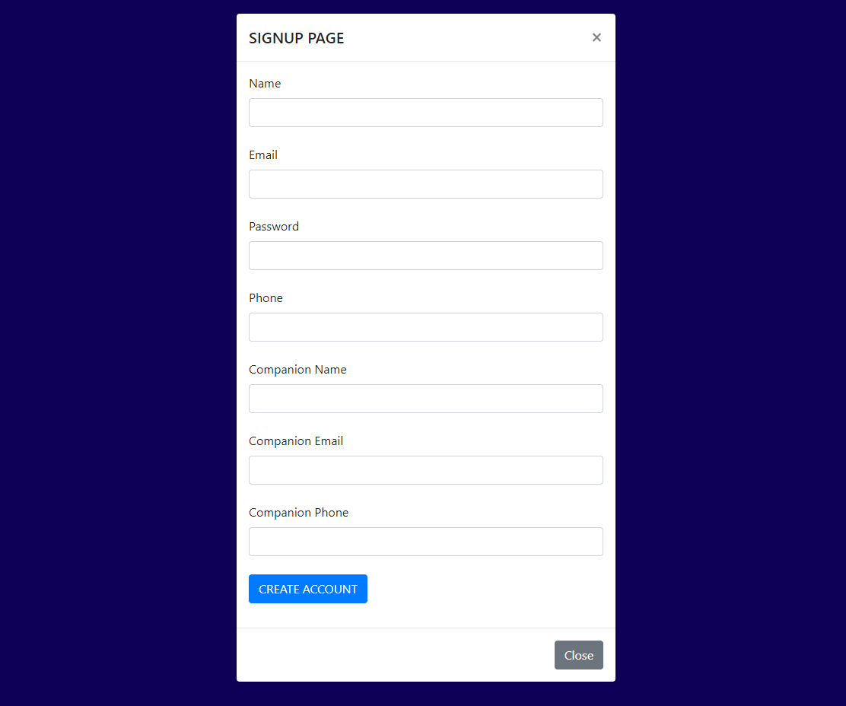
Registration and SignUp
The user registers her details as well as her companion’s details.
Password is encrypted with an encryption algorithm(it will be stored in hashed password format).

Slide 8
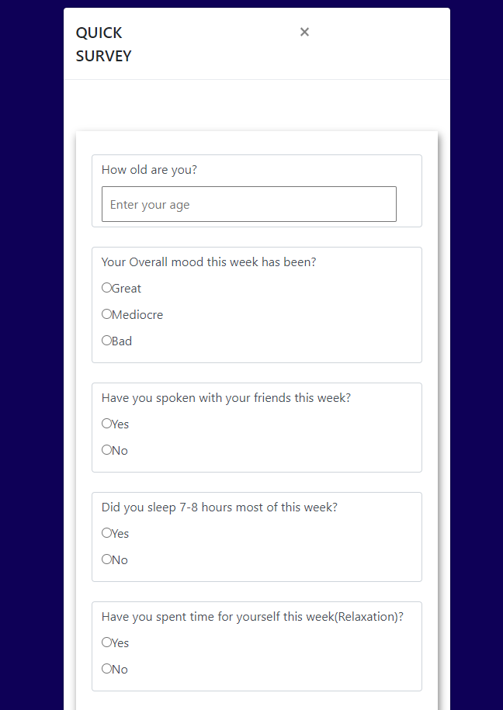
Mental Health Assessment
Multiple Choice type answers are assigned points.
Text based answers are processed using NLP and given points
Mental Health Score is determined based on combination of points from MCQ and from the sentiment analysis of typed answers.

Slide 9
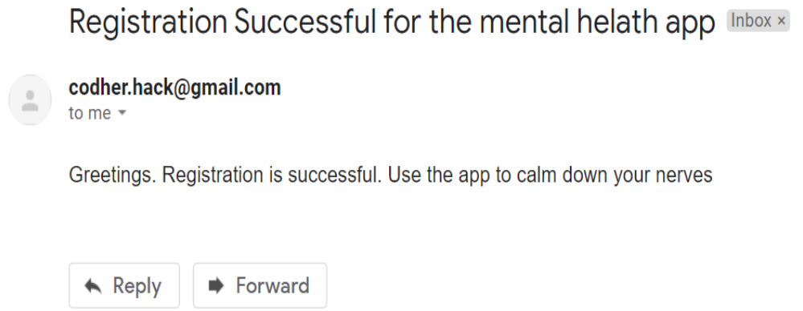
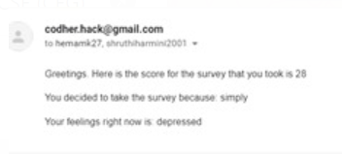
Sending Email
User and his companion are notified via email after successful registration is complete
User is notified via email after completion of his assessment along with his mental health report
In case of a score below the set threshold score, the report is sent to the registered companion as well

Slide 10
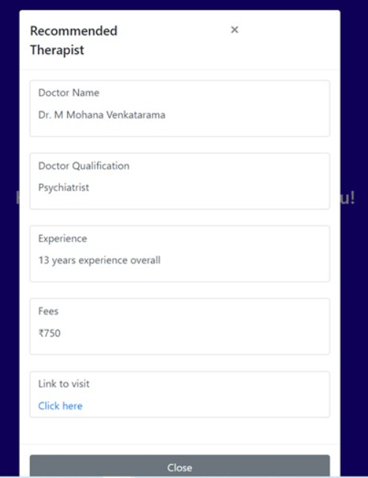
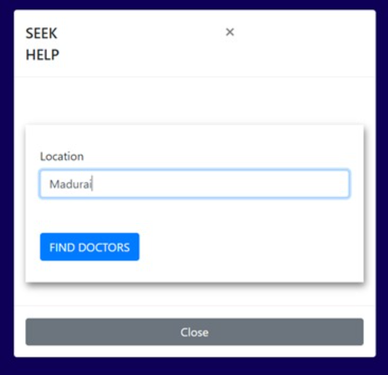
Recommend Therapist
The user provides his/her location
Top therapist from the area is suggested using Web Scraping technique.
The user will also be provided with the link and other details of the recommended therapist.

Slide 11
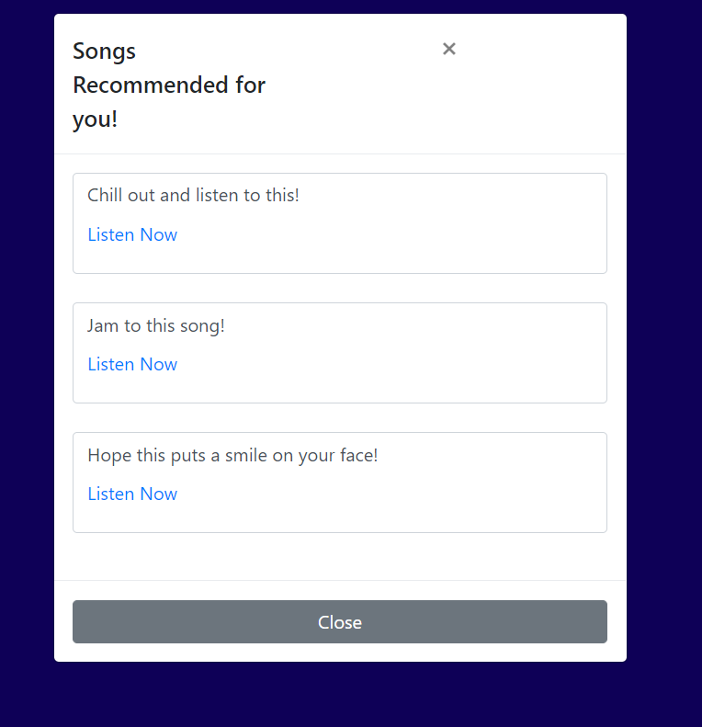
Music Recommendation
Songs are recommended from our Music Database
Genre is chosen based on Mental Health Score predicted from our Sentiment analysis algorithm.

Slide 12

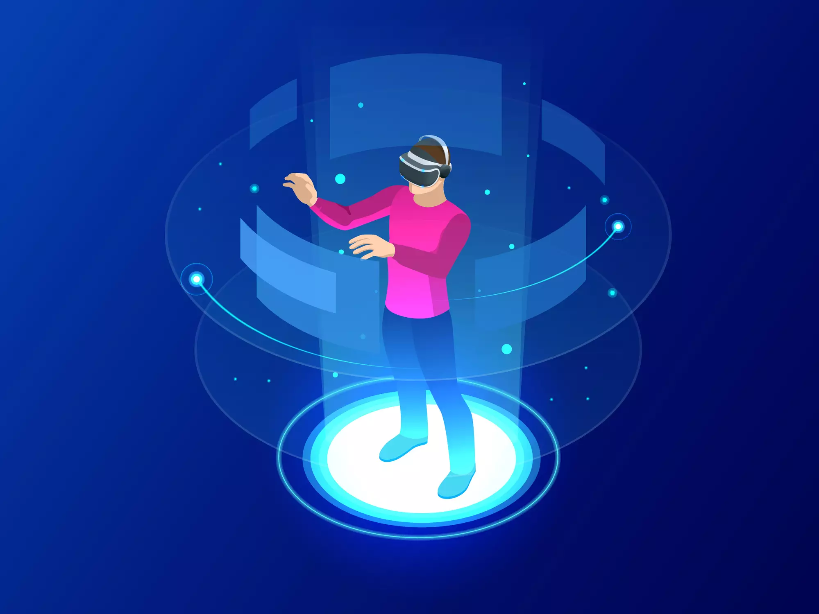
Future Scope
A Chat Bot that can ask the survey questions
A Progress Dashboard for users to view their analysis and progress across multiple weeks or months
An Augmented or Virtual Reality setup for users to create avatars and interact with friends/ therapists.

Slide 13
Thank You
Team :25
Shruthi Muthukumar
Shakthi Prarthana V
Abirami Mahesh Vijay

